Slide 1
Session 28 : Android Services
Module 4.3 : Android

Slide 2
Learning Objectives
At the end of the session successful participants will be able to
Create a Service
Start and Stop a Service
Start Long Running Work
Send Control Messages to a Service
Implement Service Lifecycle
Start and stop background services

Slide 3
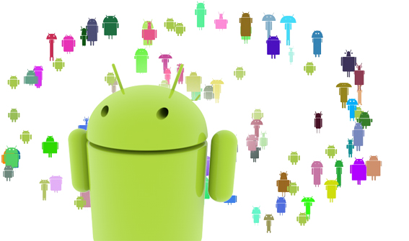
Android Services
Service
A Service is an application component that runs in the background, not interacting with the user, for an indefinite period of time.

Slide 4
Android Services
Service
Services, like other application objects, run in the main thread of their hosting process. This means that, if your service is going to do any CPU intensive (such as MP3 playback) or blocking (such as networking) operations, it should spawn its own thread in which to do that work.
Each service class must have a corresponding <service> declaration in its package's AndroidManifest.xml.
Services can be started with Context.startService() and Context.bindService().

Slide 5
Android Services
Service
Multiple calls to Context.startService() do not nest (though they do result in multiple corresponding calls to the onStart() method of the Service class), so no matter how many times it is started a service will be stopped once Context.stopService() or stopSelf() is called.
A service can be started and allowed to run until someone stops it or it stops itself. Only onestopService() call is needed to stop the service, no matter how many timesstartService() was called.

Slide 6
Android Services
Service Life Cycle
Like an activity, a service has lifecycle methods that you can implement to monitor changes in its state. But they are fewer than the activity methods —only three —and they are public, not protected:
onCreate
onStart
onDestroy
void onCreate()
void onStart(Intentintent)
void onDestroy()

Slide 7
Android Services
Service Life Cycle
The entire life time of a service happens between the time onCreate() is called and the time onDestroy() returns.
Like an activity, a service does its initial setup in onCreate(), and releases all remaining resources in onDestroy().
Example: A music playback service could create the thread where the music will be played in onCreate(), and then stop the thread in onDestroy().

Slide 8
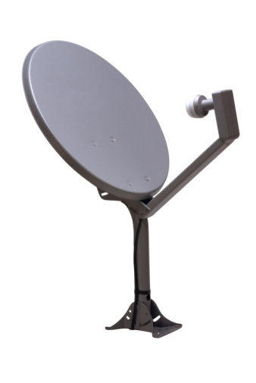
Android Services
Broadcast Receiver Lifecycle
A Broadcast Receiver is an application class that listens for Intents that are broadcast, rather than being sent to a single target application/activity.

Slide 9
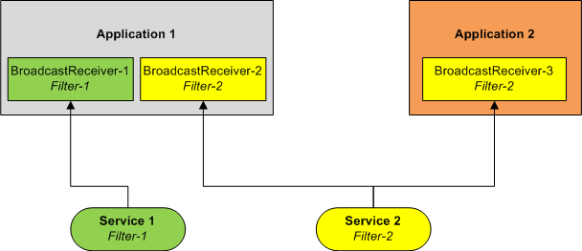
Android Services
Broadcast Receiver Lifecycle
The system delivers a broadcast Intent to all interested broadcast receivers, which handle the Intent sequentially.

Slide 10
Android Services
Registering a Broadcast Receiver
You can either dynamically register an instance of this class with Context.registerReceiver()
OR
Statically publish an implementation through the <receiver> tag in your AndroidManifest.xml.

Slide 11
Android Services
Broadcast Receiver Lifecycle
A broadcast receiver has a single callback method:
void onReceive(ContextcurContext, IntentbroadcastMsg)
When a broadcast message arrives for the receiver, Android calls its onReceive() method and passes it the Intent object containing the message.
The broadcast receiver is considered to be active only while it is executing this method.
When onReceive() returns, it is inactive.

Slide 12
Android Services
Services, Broadcast Receivers & The AdroidManifest
The manifest of applications using Android Services must include:
A <service> entry for each service used in the application.
If the application defines a Broadcast Receiver as an independent class, it must include a <receiver> clause identifying the component. In addition an <intent-filter> entry is needed to declare the actual filter the service and the receiver use.

Slide 13
Android Services
Services, Broadcast Receivers & The AdroidManifest
Example
AdroidManifest<?xml version="1.0" encoding="utf-8"?><manifest xmlns:android="http://schemas.android.com/apk/res/android"package="cis493.demos" android:versionCode="1" android:versionName="1.0.0"><uses-sdkandroid:minSdkVersion="4"></uses-sdk><application android:icon="@drawable/icon" android:label="@string/app_name"><activity android:name=".MyServiceDriver2“><intent-filter><action android:name="android.intent.action.MAIN" /><category android:name="android.intent.category.LAUNCHER" /></intent-filter></activity><service android:name="MyService2" /><receiver android:name="MyBroadcastReceiver"><intent-filter><action android:name= "matos.action.GOSERVICE2" /></intent-filter></receiver></application></manifest>

Slide 14
Android Services
Types of Broadcasts
There are two major classes of broadcasts that can be received:
Normal Broadcasts
Normal broadcasts (sent with Context.sendBroadcast) are completely asynchronous. All receivers of the broadcast are run in an undefined order, often at the same time.

Slide 15
Android Services
Types of Broadcasts
There are two major classes of broadcasts that can be received:
Normal Broadcasts
Ordered broadcasts (sent with Context.sendOrderedBroadcast) are delivered to one receiver at a time. As each receiver executes in turn, it can propagate a result to the next receiver, or it can completely abort the broadcast so that it won't be passed to other receivers. The order receivers run in can be controlled with the android:priority attribute of the matching intent-filter; receivers with the same priority will be run in an arbitrary order.

Slide 16
Android Services
Useful Methods – The Driver
Assume main activity MyService3Driverwants to interact with a service called MyService3. The main activity is responsible for the following tasks:
Start the service called MyService3.
Intent intentMyService= newIntent(this, MyService3.class);
Service myService= startService(intentMyService);

Slide 17
Android Services
Useful Methods – The Driver
Assume main activity MyService3Driverwants to interact with a service called MyService3. The main activity is responsible for the following tasks:
Define corresponding receiver’s filter and register local receiver
IntentFiltermainFilter= newIntentFilter("matos.action.GOSERVICE3");
BroadcastReceiverreceiver= newMyMainLocalReceiver();
registerReceiver(receiver, mainFilter);

Slide 18
Android Services
Useful Methods – The Driver
Assume main activity MyService3Driverwants to interact with a service called MyService3. The main activity is responsible for the following tasks:
Implement local receiver and override its main method
publicvoidonReceive(Context localContext, Intent callerIntent)

Slide 19
Android Services
Useful Methods – The Service
Assume main activity MyService3Driver wants to interact with a service called MyService3. The Service uses its onStart method to do the following:
Create an Intent with the appropriate broadcast filter (any number of receivers could match it).
Intent myFilteredResponse= newIntent("matos.action.GOSERVICE3");

Slide 20
Android Services
Useful Methods – The Service
Assume main activity MyService3Driver wants to interact with a service called MyService3. The Service uses its onStart method to do the following:
Prepare the extra data (‘myServiceData’) to be sent with the intent to the receiver(s)
Object msg= some user data goes here;
myFilteredResponse.putExtra("myServiceData", msg);

Slide 21
Android Services
Useful Methods – The Service
Assume main activity MyService3Driver wants to interact with a service called MyService3. The Service uses its onStart method to do the following:
Release the intent to all receivers matching the filter
sendBroadcast(myFilteredResponse);

Slide 22
Android Services
Useful Methods – The Driver (Again)
Assume main activity MyService3Driver wants to interact with a service called MyService3. The main activity is responsible for cleanly terminating the service. Do the following
Assume intentMyServiceis the original Intent used to start the service. Calling the termination of the service is accomplished by the method
stopService(newIntent(intentMyService) );

Slide 23
Android Services
Useful Methods – The Driver (Again)
Assume main activity MyService3Driver wants to interact with a service called MyService3. The main activity is responsible for cleanly terminating the service. Do the following
Use the service’s onDestroy method to assure that all of its running threads are terminated and the receiver is unregistered.
unregisterReceiver(receiver);

Slide 24
Android Services
A Very Simple Service: Example - 1
The main application starts a service. The service prints lines on the DDMS LogCat until the main activity stops the service. No IPC occurs in the example.
// a simple service is started & stopped
package cis493.demos;
import android.app.Activity;
import android.content.ComponentName;
import android.content.Intent;
import android.os.Bundle;
import android.view.View;
import android.view.View.OnClickListener;
import android.widget.*;
public class ServiceDriver1 extends Activity {

Slide 25
Android Services
A Very Simple Service: Example - 1
The main application starts a service. The service prints lines on the DDMS LogCat until the main activity stops the service. No IPC occurs in the example.
TextViewtxtMsg;
Button btnStopService;
ComponentNameservice;
Intent intentMyService;
@Override
public void onCreate(Bundle savedInstanceState) {
super.onCreate(savedInstanceState);
setContentView(R.layout.main);
txtMsg= (TextView) findViewById(R.id.txtMsg);
intentMyService= new Intent(this, MyService1.class);

Slide 26
Android Services
A Very Simple Service: Example - 1
The main application starts a service. The service prints lines on the DDMS LogCat until the main activity stops the service. No IPC occurs in the example.
service = startService(intentMyService);
btnStopService= (Button) findViewById(R.id.btnStopService);
btnStopService.setOnClickListener(new OnClickListener() {
public void onClick(View v) {
try {
stopService((intentMyService) );
txtMsg.setText("After stopingService: \n" + service.getClassName());
} catch (Exception e) {
Toast.makeText(getApplicationContext(), e.getMessage(), 1).show();}}});}}

Slide 27
Android Services
A Very Simple Service: Example - 1
The main application starts a service. The service prints lines on the DDMS LogCat until the main activity stops the service. No IPC occurs in the example.
//non CPU intensive service running the main task in its main thread
packagecis493.demos;
importandroid.app.Service;
importandroid.content.Intent;
importandroid.os.IBinder;
importandroid.util.Log;
publicclassMyService1 extendsService {
@Override
publicIBinderonBind(Intent arg0) {

Slide 28
Android Services
A Very Simple Service: Example - 1
The main application starts a service. The service prints lines on the DDMS LogCat until the main activity stops the service. No IPC occurs in the example.
returnnull;
}
@Override
publicvoidonCreate() {
super.onCreate();
Log.i("<<MyService1-onStart>>", "I am alive-1!");
}
@Override
publicvoidonStart(Intent intent, intstartId) {
super.onStart(intent, startId);

Slide 29
Android Services
A Very Simple Service: Example - 1
The main application starts a service. The service prints lines on the DDMS LogCat until the main activity stops the service. No IPC occurs in the example.
Log.i("<<MyService1-onStart>>", "I did something very quickly");
}
@Override
publicvoidonDestroy() {
super.onDestroy();
Log.i("<<MyService1-onDestroy>>", "I am dead-1");
}
}//MyService1

Slide 30
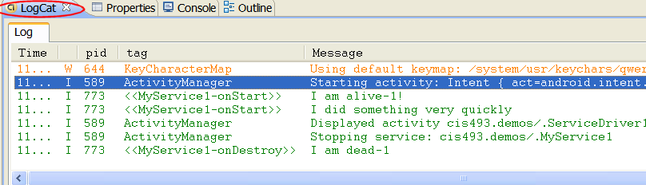
Android Services
A Very Simple Service: Example - 1

Slide 31
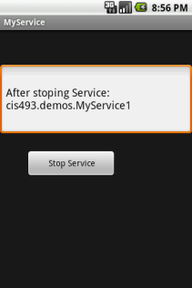
Android Services
A Very Simple Service: Example - 1
According to the Log:
Main Activity is started (no displayed yet)
Service is started (onCreate, onStart)
Main Activity UI is displayed
ser stops Service

Slide 32
Android Services
A Very Simple Service: Example - 1
Manifest
<?xml version="1.0" encoding="utf-8"?>
<manifest xmlns:android="http://schemas.android.com/apk/res/android"
package="cis493.demos"
android:versionCode="1"
android:versionName="1.0">
<application android:icon="@drawable/icon"
android:label="@string/app_name">
<activity android:name=".ServiceDriver1"
android:label="@string/app_name">
<intent-filter>

Slide 33
Android Services
A Very Simple Service: Example - 1
Manifest
<action android:name="android.intent.action.MAIN" />
<category android:name="android.intent.category.LAUNCHER" />
</intent-filter>
</activity>
<service android:name=".MyService1"> </service>
</application>
<uses-sdkandroid:minSdkVersion="4" />
</manifest>

Slide 34
Android Services
A Very Simple Service: Example - 1
Layout
<?xml version="1.0" encoding="utf-8"?><AbsoluteLayoutandroid:id="@+id/widget32"android:layout_width="fill_parent"android:layout_height="fill_parent"xmlns:android="http://schemas.android.com/apk/res/android"><EditTextandroid:id="@+id/txtMsg"android:layout_width="fill_parent"android:layout_height="120px"android:textSize="18sp"android:layout_x="0px"android:layout_y="57px"></EditText><Buttonandroid:id="@+id/btnStopService"android:layout_width="151px"android:layout_height="wrap_content"android:text=" Stop Service"android:layout_x="43px"android:layout_y="200px"></Button></AbsoluteLayout>

Slide 35
Android Services
A Very Simple Service: Example - 1
Realistic Activity - Service Interaction
The main activity starts the service and registers a receiver.
The service is slow, therefore it runs in a parallel thread its time consuming task.
When done with a computing cycle, the service adds a message to an intent.

Slide 36
Android Services
A Very Simple Service: Example - 1
Realistic Activity - Service Interaction
The intent is broadcasted using the filter: matos.action.GOSERVICE3.
A BroadcastReceiver (defined inside the main Activity) uses the previous filter and catches the message (displays the contents on the main UI ).
At some point the main activity stops the service and finishes executing.

Slide 37
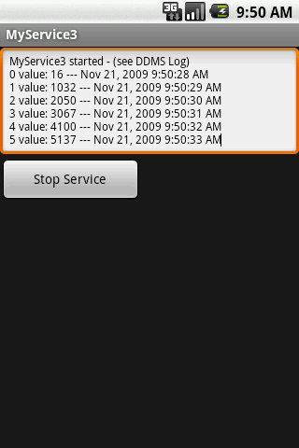
Android Services
A Very Simple Service: Example - 1
Layout
<?xml version="1.0" encoding="utf-8"?>
<LinearLayout
android:id="@+id/widget32"
android:layout_width="fill_parent"
android:layout_height="fill_parent"
android:orientation="vertical"
xmlns:android="http://schemas.android.com/apk/res/android"
>
<EditText
android:id="@+id/txtMsg"
android:layout_width="fill_parent”

Slide 38
Android Services
A Very Simple Service: Example - 1
Layout
android:layout_height="120px"
android:textSize="12sp"
>
</EditText>
<Button
android:id="@+id/btnStopService"
android:layout_width="151px"
android:layout_height="wrap_content"
android:text="Stop Service"
>
</Button>
</LinearLayout>

Slide 39
Android Services
A Very Simple Service: Example - 1
Manifest
<?xml version="1.0" encoding="utf-8"?><manifest xmlns:android="http://schemas.android.com/apk/res/android"package="cis493.demos"android:versionCode="1"android:versionName="1.0.0"><uses-sdkandroid:minSdkVersion="4"></uses-sdk> <application android:icon="@drawable/icon" android:label="@string/app_name"><activity android:name=".MyServiceDriver3"android:label="@string/app_name"><intent-filter><action android:name="android.intent.action.MAIN" /><category android:name="android.intent.category.LAUNCHER" /></intent-filter></activity><service android:name="MyService3"></service></application></manifest>

Slide 40
Android Services
A Very Simple Service: Example - 2
Main Activity
// Application logic and its BroadcastReceiverin the same class
package cis493.demos;
import java.util.Date;
import android.app.Activity;
import android.content.BroadcastReceiver;
import android.content.ComponentName;
import android.content.Context;
import android.content.Intent;
import android.content.IntentFilter;
import android.os.Bundle;
import android.os.SystemClock;

Slide 41
Android Services
A Very Simple Service: Example - 2
Main Activity
import android.util.Log;
import android.view.View;
import android.view.View.OnClickListener;
import android.widget.*;
public class MyServiceDriver3 extends Activity {
TextViewtxtMsg;
Button btnStopService;
ComponentNameservice;
Intent intentMyService;
BroadcastReceiverreceiver;
13@OverridepublicvoidonCreate(Bundle savedInstanceState) {super.onCreate(savedInstanceState);setContentView(R.layout.

Slide 42
Android Services
A Very Simple Service: Example - 2
Main Activity
);txtMsg= (TextView) findViewById(R.id.txtMsg); intentMyService= newIntent(this, MyService3.class); service= startService(intentMyService); txtMsg.setText("MyService3 started -(see DDMS Log)"); btnStopService= (Button) findViewById(R.id.btnStopService);btnStopService.setOnClickListener(newOnClickListener() {publicvoidonClick(View v) {try{stopService(newIntent(intentMyService) );txtMsg.setText("After stopingService: \n"+ service.getClassName());} catch(Exception e) {e.printStackTrace();}} });
// register & define filter for local listener
IntentFiltermainFilter= newIntentFilter("matos.action.GOSERVICE3");
receiver= newMyMainLocalReceiver();

Slide 43
Android Services
A Very Simple Service: Example - 2
Main Activity
registerReceiver(receiver, mainFilter);
}//onCreate
////////////////////////////////////////////////////////////////////////
@Override
protected void onDestroy() {
super.onDestroy();
try{
stopService(intentMyService);
unregisterReceiver(receiver);
} catch(Exception e) {
Log.e("MAIN3-DESTROY>>>", e.getMessage() );

Slide 44
Android Services
A Very Simple Service: Example - 2
Main Activity
}
Log.e("MAIN3-DESTROY>>>", "Adios");
}//onDestroy
//////////////////////////////////////////////////////////////////////
// local (embedded) RECEIVER
public class MyMainLocalReceiver extends BroadcastReceiver{
@Override
publicvoidonReceive(Context localContext, Intent callerIntent) {
String serviceData= callerIntent.getStringExtra("serviceData");
Log.e("MAIN>>>", serviceData+ " -receiving data “

Slide 45
Android Services
A Very Simple Service: Example - 2
Main Activity
+ SystemClock.elapsedRealtime() );
String now = "\n"+ serviceData+ " ---"
+ newDate().toLocaleString();
txtMsg.append(now);
}
}//MyMainLocalReceiver
}//MyServiceDriver4

Slide 46
Android Services
A Very Simple Service: Example - 2
The Service
// Service3 uses a thread to run slow operation
package cis493.demos;
import android.app.Service;
import android.content.Intent;
import android.os.IBinder;
import android.util.Log;
Public class MyService3 extends Service {
booleanisRunning= true;
@Override
publicIBinderonBind(Intent arg0) {
return null;
}

Slide 47
Android Services
A Very Simple Service: Example - 2
The Service
@Override
public void onCreate() {
super.onCreate();
}
@Override
public void onStart(Intent intent, intstartId) {
super.onStart(intent, startId);
Log.e("<<MyService3-onStart>>", "I am alive-3!");
// we place the slow work of the service in its own thread
// so the caller is not hung up waiting for us
Thread triggerService= newThread ( newRunnable(){
longstartingTime= System.currentTimeMillis();

Slide 48
Android Services
A Very Simple Service: Example - 2
The Service
longtics= 0;
publicvoidrun() {
for(inti=0; (i< 120) & isRunning; i++) { //at most 10 minutes
try{
//fake that you are very busy here
tics= System.currentTimeMillis() -startingTime;
Intent myFilteredResponse= newIntent("matos.action.GOSERVICE3");
String msg= i+ " value: "+ tics;
myFilteredResponse.putExtra("serviceData", msg);
sendBroadcast(myFilteredResponse);

Slide 49
Android Services
A Very Simple Service: Example - 2
The Service
Thread.sleep(1000); //five seconds
} catch(Exception e) { e.printStackTrace(); }
}//for
}//run});
triggerService.start();
}//onStart
@Override
public void onDestroy() {
super.onDestroy();
Log.e("<<MyService3-onDestroy>>", "I am dead-3");
isRunning= false;}//onDestroy
}//MyService3

